Slide 1

Packaging and Distribution
pip
setuptools
Wheels
PyPi

Slide 2
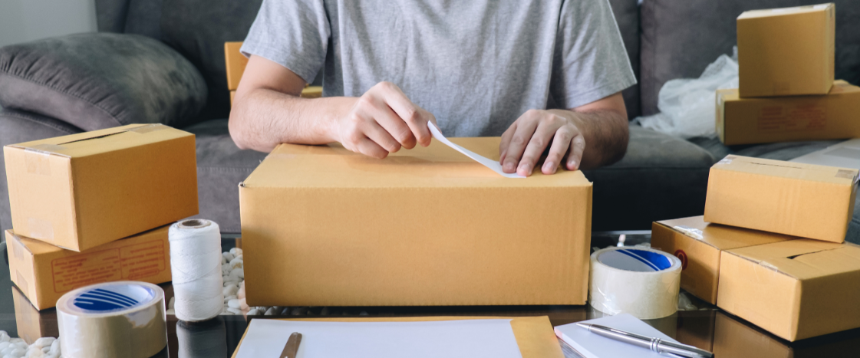
See Also
https://packaging.python.org/tutorials/installing-packages/
https://packaging.python.org/guides/distributing-packages-using-setuptools/
https://setuptools.readthedocs.io/en/latest/
Notes:
Here is some additional reading on the web.

Slide 3
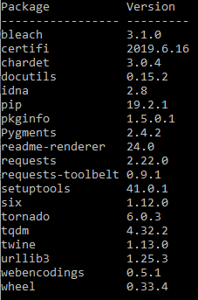
Package Installer for Python (pip)
Knows where to find common packages on the web
Installs (builds, deploys) code to your computer
C:\UAH>pip install tornado
pip remove starlight
pip list

Slide 4
setuptools
https://pythonhosted.org/an_example_pypi_project/setuptools.html
Create setup.py in the project root (see next slide)
Create a free account on http://pypi.python.org/pypi
pip install twine
python setup.py sdist (makes a compressed tarball for source)
python setup.py bdist_wheel (makes a built wheel)
twine upload dist/*
pip install dist/irobot…any.whl
pip install irobotcreate

Slide 5
setup.py
from setuptools import setup, find_packages
setup(name = 'irobotcreate',
version = '2.1',
author = 'Chris Cantrell',
author_email = 'topherCantrell@gmail.com',
description = 'Python code to control the irobotCreate2 from a raspberry pi',
license = 'MIT',
classifiers = [
'Operating System :: POSIX :: Linux',
'License :: OSI Approved :: MIT License',
'Intended Audience :: Developers',
'Programming Language :: Python :: 3',
'Topic :: Software Development',
'Topic :: System :: Hardware'],
url = 'https://github.com/topherCantrell/robots-piCreate',
install_requires = [
'serial'
],
packages = find_packages())

